Slide 1
IoT Prototype to Product
Smart Garbage bin

Slide 2
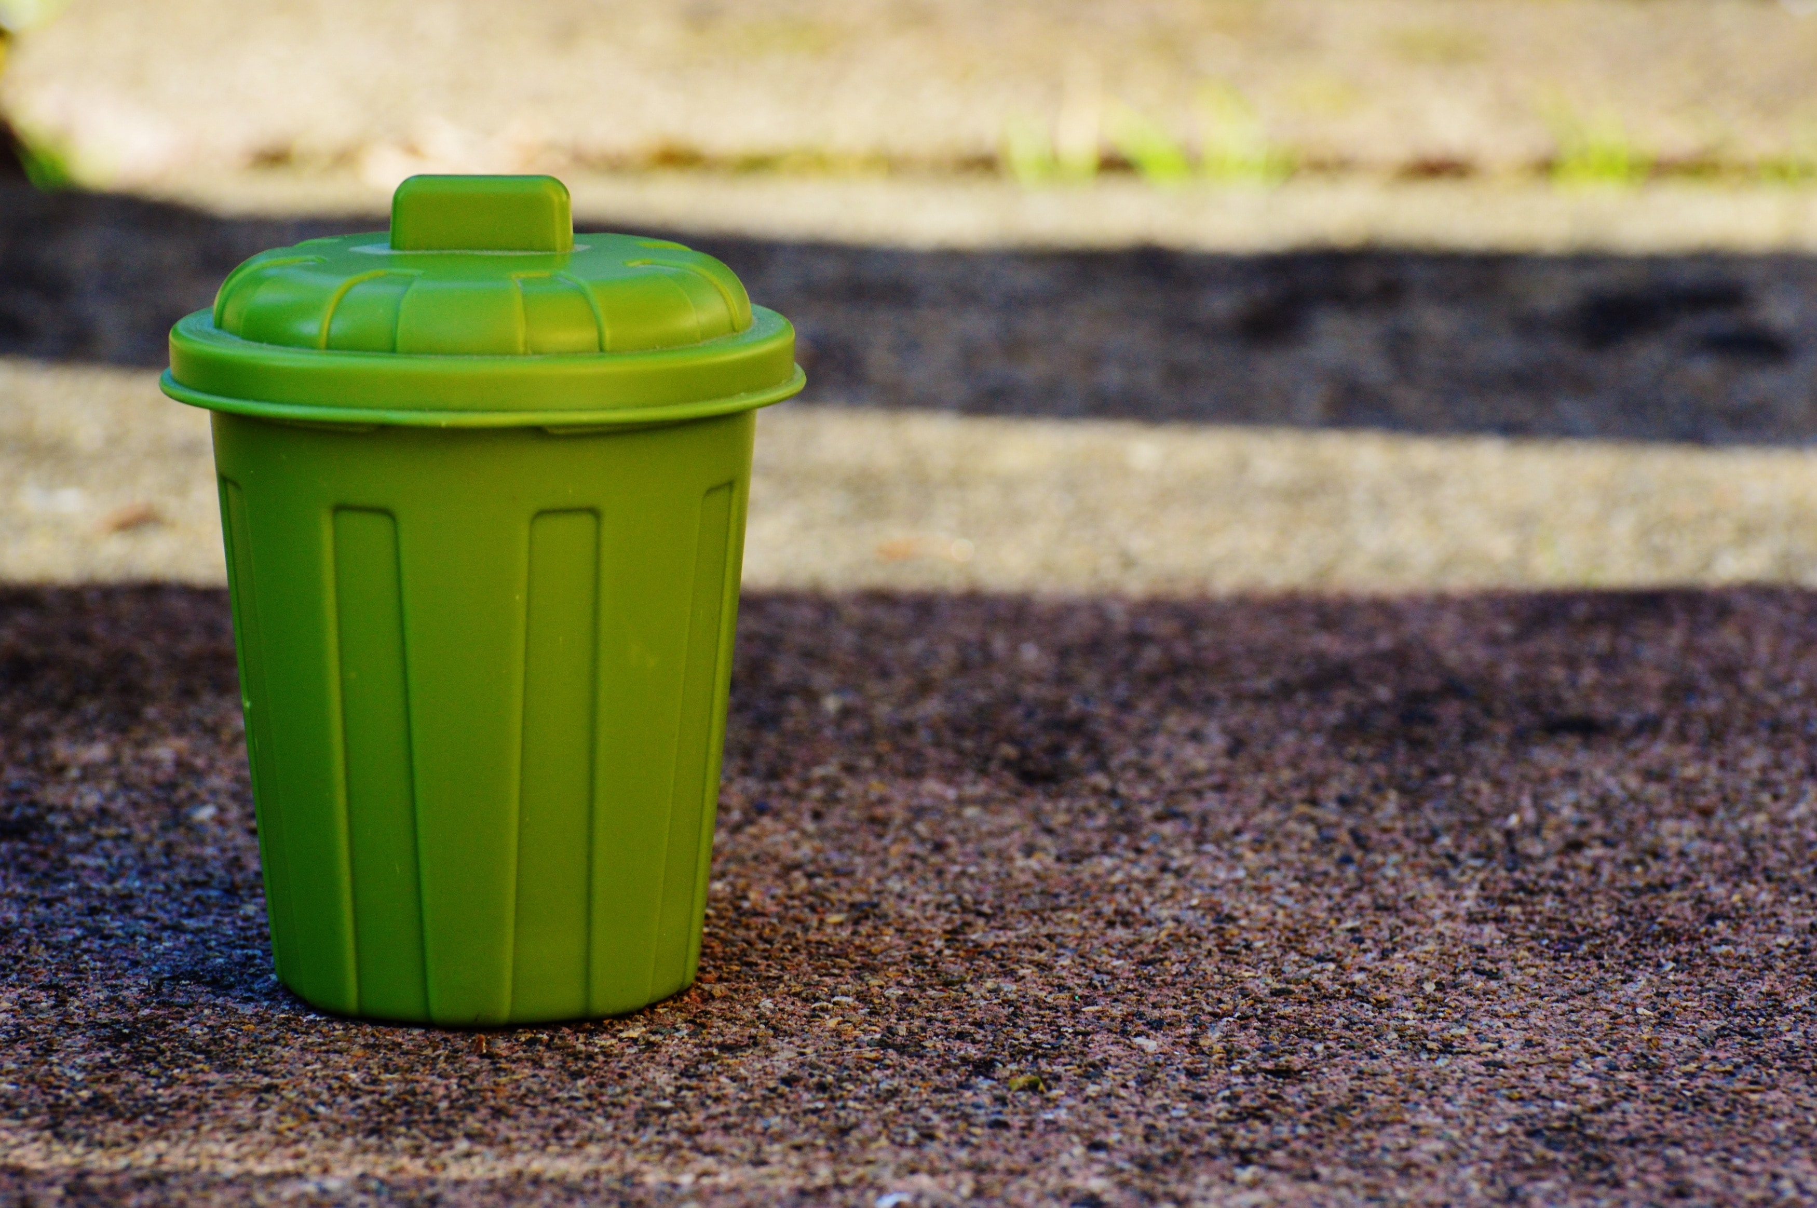

Slide 3
IPP Model
Step 0
Ideation and Validation
Step 1
Selection of Processor
Step 2
Sensors, Actuators and Networking Link [H/W]
Step 3
Step 4
Step 5
Cloud (Server , DB , Dashboard UI)
S/W Development
Prototype to Product

Slide 4
Problem
Idea
Validation
Step 0
Ideation and Validation

Slide 5
Reasons why we need smart bins
A reduction in the number of waste collections needed by up to 80%, resulting in less manpower, emissions, fuel use and traffic congestion
A reduction in the number of waste bins needed
Analytics data to manage collection routes and the placement of bins more effectively
Improved environment (i.e. no overflowing bins and less unpleasant odours)

Slide 6
Idea : Independent module
What it does :
Level and temperature monitoring in real time : A device to be fit into the dustbin which sends the level of bin filled and temperature inside the bin to the Municipal board. The municipal board will be provided with a dashboard that shows the level and temperature of the bins situated across the city. Periodic monitoring (Level and Temperature) and location of the bin is collected on the cloud.

Slide 7
validation
According to a report published in Nature journal, the problem of garbage or solid waste is assuming terrible proportions today.
At present, people of India produce about 62 million tonnes of solid-waste annually. According to the report, urban India generates 109,589 tonnes of waste per day.
Smart Bins help to create a cleaner, safer, more hygienic environment and enhanced operational efficiency while reducing management costs, resources, and road-side emissions.
These technologies can provide visibility on solid waste management, route planning for garbage collection, resource optimization, efficient asset management, efficient maintenance, visibility of waste bins etc.
Automated waste collection system provides long term solution and can take care the conventional methods like door-to-door, community bins collections and transportation via sloping channel system.
The Smart Bin is ideal for busy locations such as campuses, theme parks, airports, railway stations, and shopping malls.

Slide 8
Step 1
Selection of Processor
Processor
Development Board

Slide 9
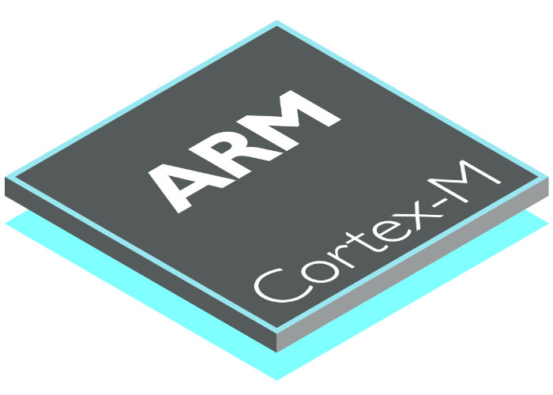
Processor
ARM Cortex M0+/M3/M4
ARMv7-M architecture
3-stage pipeline with branch speculation.
Instruction sets:
Thumb-1 (entire).
Thumb-2 (entire).
32-bit hardware integer multiply with 32-bit or 64-bit result, signed or unsigned, add or subtract after the multiply. 32-bit multiply is 1 cycle, but 64-bit multiply and MAC instructions require extra cycles.
32-bit hardware integer divide (2–12 cycles).
saturation arithmetic support.
1 to 240 interrupts, plus NMI.
12 cycle interrupt latency.
Integrated sleep modes.

Slide 10
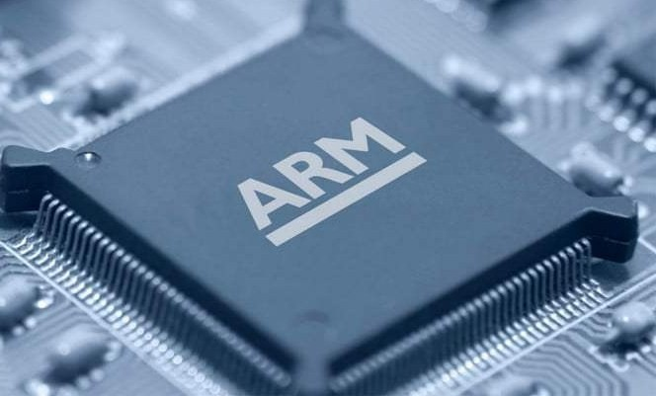
Processor
ARM7TDMI
32/16-bit RISC architecture (ARM v4T)
32-bit ARM instruction set for maximum performance and flexibility
16-bit Thumb instruction set for increased code density
Unified bus interface, 32-bit data bus carries both instructions and data
Three-stage pipeline
32-bit ALU
Very small die size and low power consumption
Fully static operation
Coprocessor interface
JTAG interface unit

Slide 11
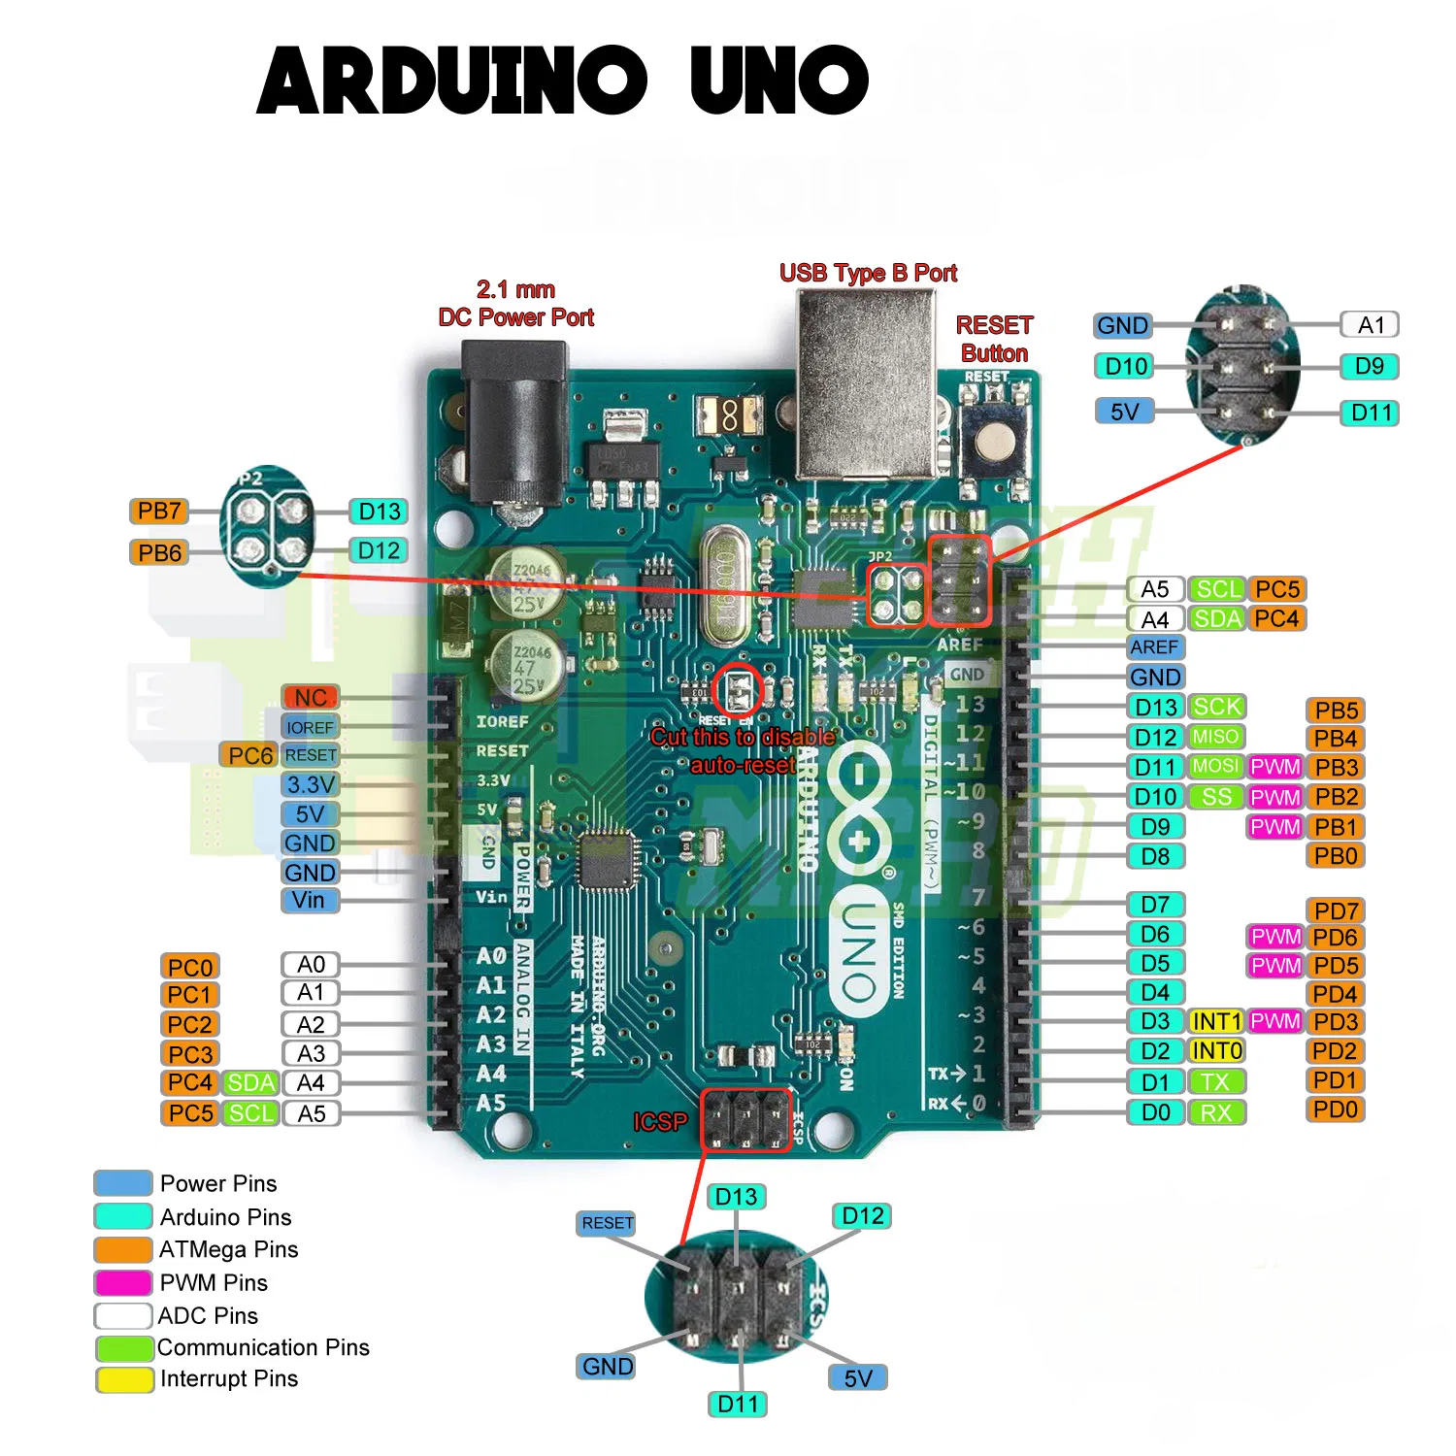
Development Board
Arduino UNO
AVR AtMega328, 2KB SRAM , 32 KB Flash (0.5 KB used by bootloader) , 1KB EEPROM , Most widely used , starting point for anyone interested in Electronics.
Available in India for Rs.500-1500

Slide 12
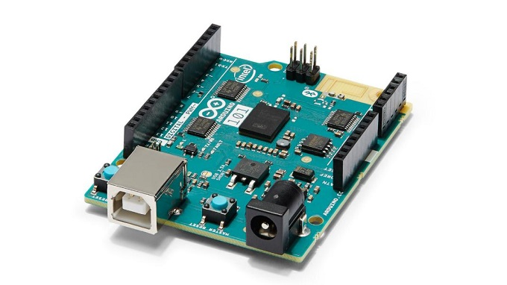
Development Board
Based on Intel Curie module , Arduino open source electronics platform for SW, Bluetooth , accelerometer and gyroscope embedded with Curie module UART , SPI
Available in India for Rs.3500
Intel Genuino 101

Slide 13
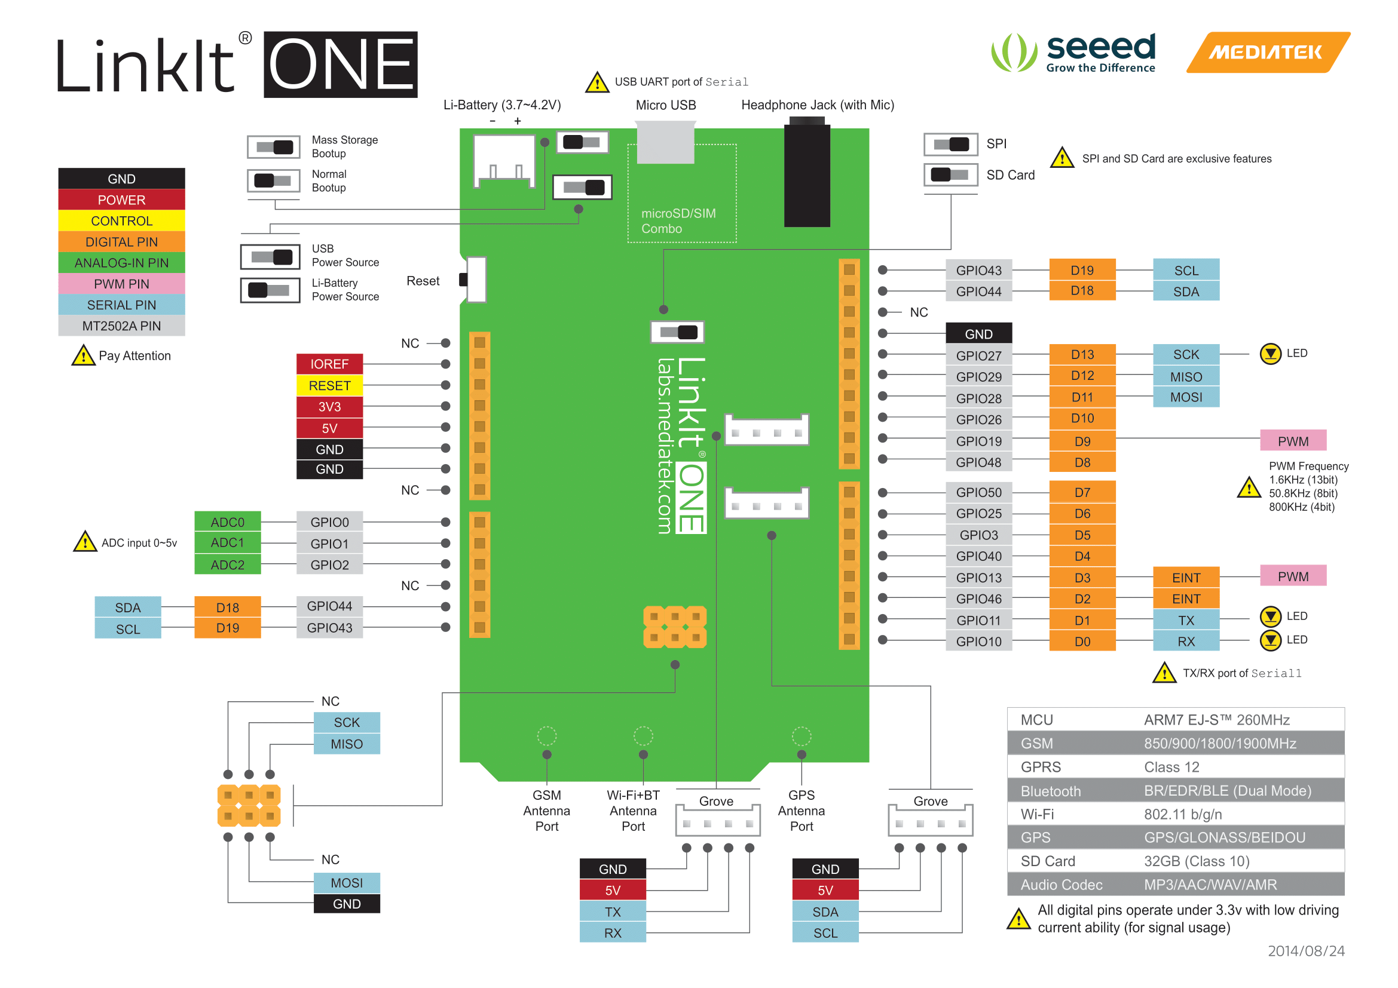
Development Board
Mediatek Linkit One
Mediatek MT2502 Aster SOC (ARM7 EJ-S, Bluetooth , GSM/GPRS , 4 MB RAM , 16 MB Flash)
On board Wi-Fi (MT5931)
GPS (MT3332), up to 32 GB SD card storage , MP3/AAC Audio (3.5mm Jack)
Normal Size SIM card holder , 1000mAh Li-ion battery
$60(Rs.7000 in India)

Slide 14
H/W Selected – ‘MediaTek Linkit One’ because …
Versatile Board for prototyping! (Connectivity options: Bluetooth , Wi-Fi , GSM and Location: GPS)
Least Development time (Arduino compatible , many libraries for Arduino are present, Arduino community support for S/W libraries, … )

Slide 15
Step 2
Sensors + Actuators Networking Link [H/W]
Sensors & Actuators
Networking Link

Slide 16
FUNCTIONALITY OF THE DEVICE
Location
Temperature
Bin Level

Slide 17
Sensors Required
S No. | Function | Parameter | Sensor
1 | Tracking | Location | GNSS Module
2 | Temperature | Temperature | TPH board
3 | Bin Level | Distance | Ultrasonic sensor

Slide 18

GNSS Module
Global navigation satellite system (GNSS) refers to a constellation of satellites providing signals from space.
All we need is GNSS receiver module which contains a processor and antenna that receives the signals sent by the satellites and computes the position and time.
If the receiver’s antenna can see at least 4 satellites, it can accurately calculate its position and time. This is called a lock or fix.
Line of sight with the sky is needed for this. But , we cannot have that always (especially for indoor applications).
The position accuracy depends on a number of variables such as signal to noise ratio, weather and obstructions such as buildings and mountains.

Slide 19
The receiver must be able to get a lock on 4 satellites to be able to solve for a position.
All these conditions make it difficult to use GNSS, but there are ways to handle these circumstances (Assisted GPS , Differential GPS).
For the GNSS we are using the Mediatek module present on board with Linkit one.
The chipset is Mediatek MT3332 which is present on the Linkit one board.
MT3332 supports various location and navigation applications, including autonomous GPS (USA) , GLONASS (Russia) , GALILEO (EU) , BEIDOU (China)
We have an antenna also , that comes with the board. So , the hardware is ready. To access the Hardware, we have to use the functions provided by the Software development kit of Linkit one board.

Slide 20
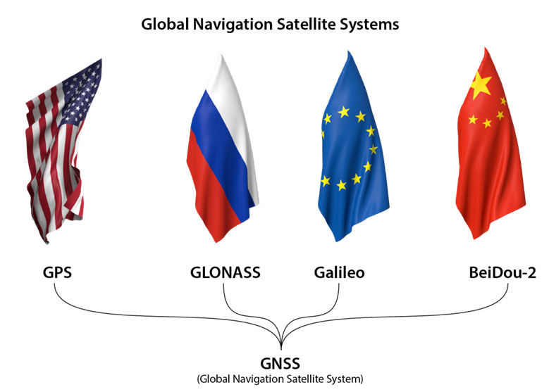

Slide 21
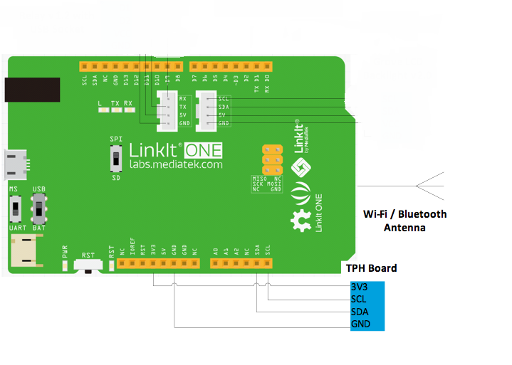
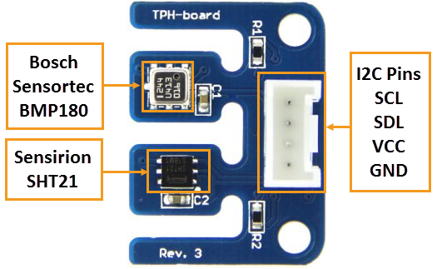
TPH board
This board has the Sensirion SHT21 humidity sensor and the Bosch Sensortec BMP180 pressure sensor (both capable of measuring temperature). TPH-board is 3.3 volt and 5V compatible, which makes it perfect to use with boards 5V Arduino boards.
Both the SHT21 and the BMP180 are connected through the I2C/TWI with the easy Grove-header. Pull-up resistors are available on the TPH-board, but if undesired you can disconnect them through the cut-trace on the back.

Slide 22
The Bosch Sensortec BMP180 is a new high-precision barometric pressure sensor. The pressure range is 300 to 1100 hPa and has a high relative accuracy of +/-0.12hPa (+/-1m).
The Sensirion SHT21 is a digital humidity sensor. The relative humidity (RH) operating range is from 0 to 100% RH and has a precision of 0.04% RH.
Interface
Controller | TPH board
3v3 | 3v3
SCL(D19) | SCL
SDA(D18) | SDA
GND | GND

Slide 23
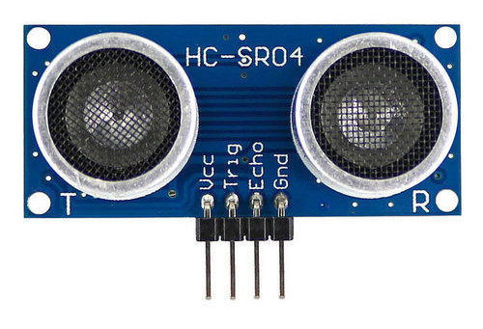
HC-SR04 Ultrasonic Distance Sensor
Interface
Controller | TPH board
5V | VCC
D12 | Trig
D11 | Echo
GND | GND
The HC-SR04 Ultrasonic (US) sensor is a 4 pin module, whose pin names are VCC , Trigger, Echo and Ground respectively. This sensor is used in many applications where measuring distance or sensing objects are required. The module has two eyes like projects in the front which forms the Ultrasonic transmitter and Receiver. The sensor works with the simple high school formula that
Distance = Speed × Time

Slide 24
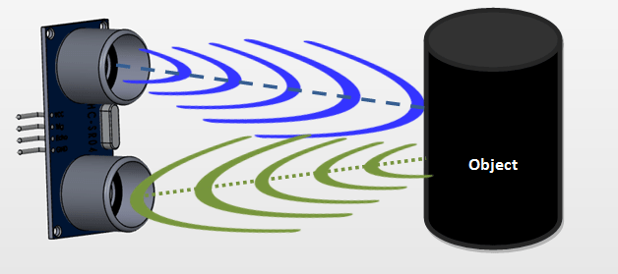
The Ultrasonic transmitter transmits an ultrasonic wave, this wave travels in air and when it gets objected by any material it gets reflected back toward the sensor this reflected wave is observed by the Ultrasonic receiver module as shown in the picture below
Power the Sensor using a regulated +5V through the VCC ad Ground pins of the sensor. The current consumed by the sensor is less than 15mA and hence can be directly powered by the on board 5V pins (If available). The Trigger and the Echo pins are both I/O pins and hence they can be connected to I/O pins of the microcontroller. To start the measurement, the trigger pin has to be made high for 10uS and then turned off. This action will trigger an ultrasonic wave at frequency of 40Hz from the transmitter and the receiver will wait for the wave to return. Once the wave is returned after it getting reflected by any object the Echo pin goes high for a particular amount of time which will be equal to the time taken for the wave to return back to the sensor.
The amount of time during which the Echo pin stays high is measured by the MCU/MPU as it gives the information about the time taken for the wave to return back to the Sensor. Using this information the distance is measured as explained in the above heading.

Slide 25
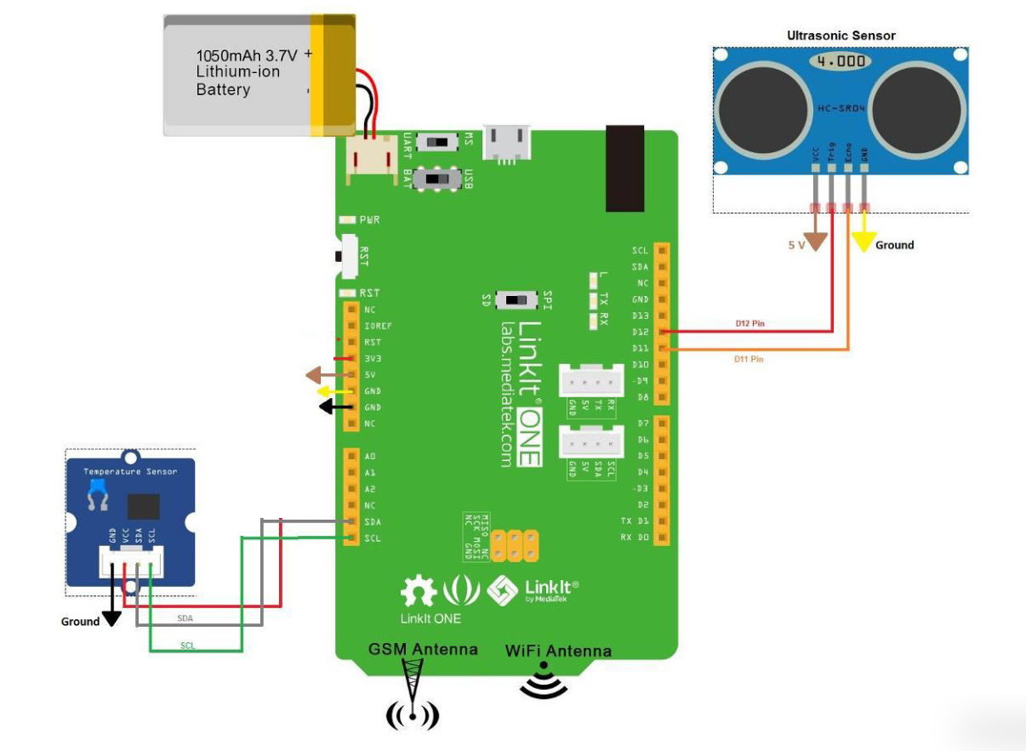
Circuit Diagram

Slide 26
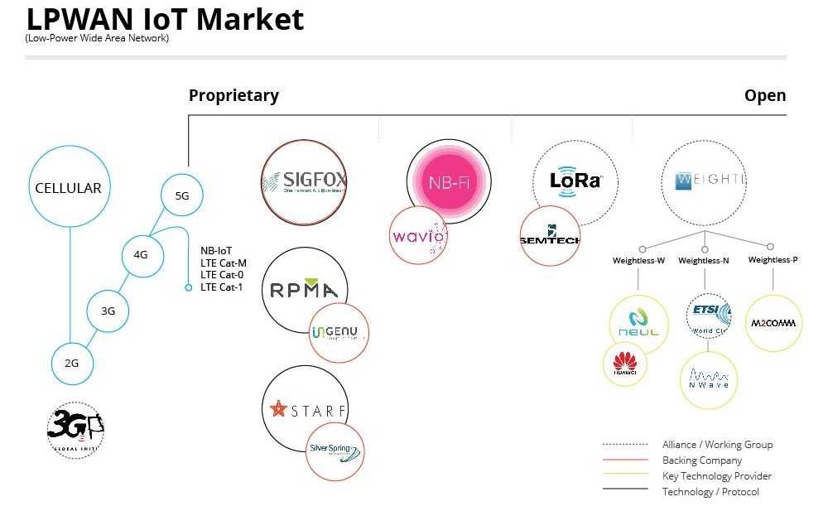
Networking Links

Slide 27
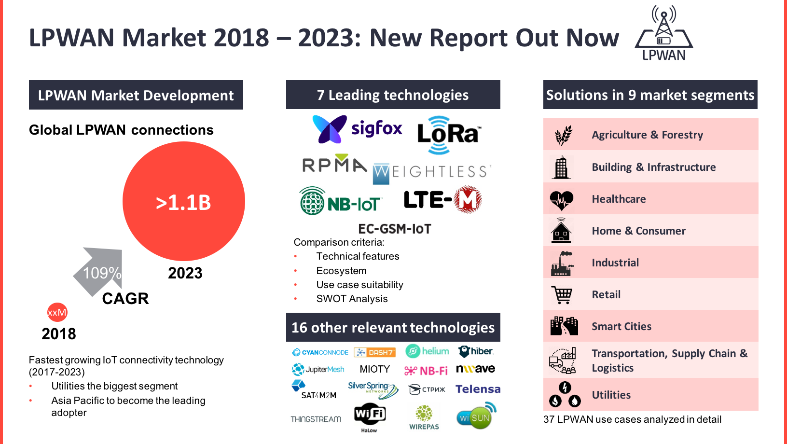

Slide 28
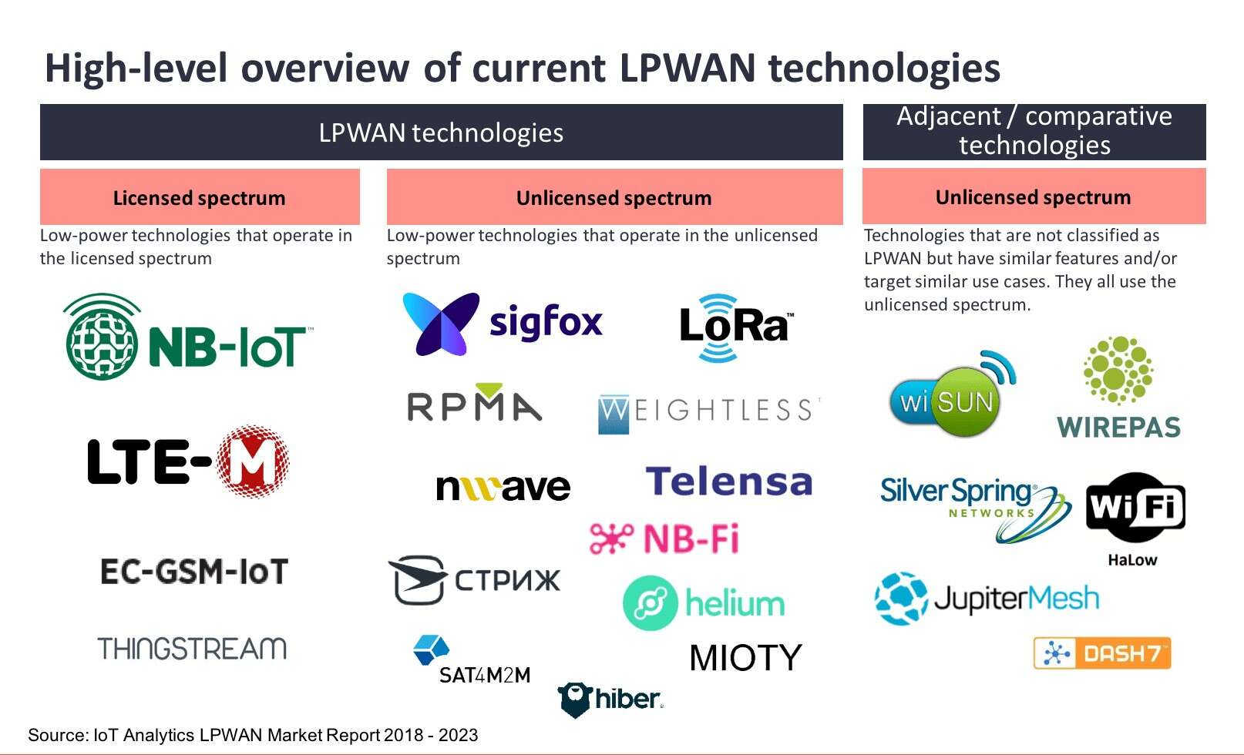

Slide 29
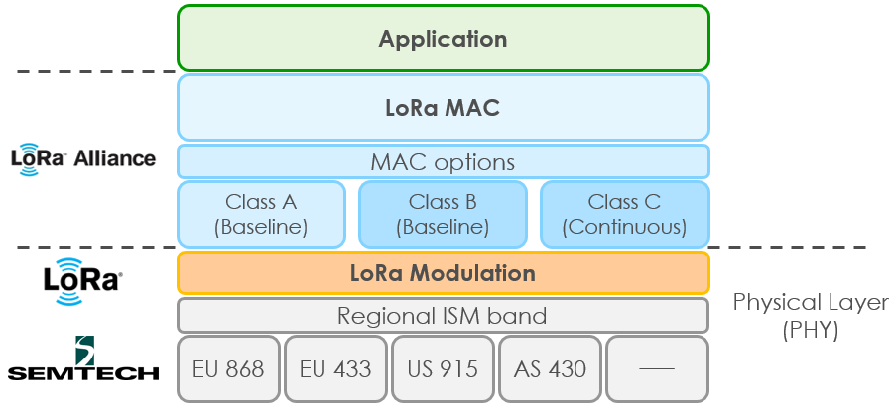
LoRaWAN
An LPWAN specification intended for wireless battery operated IoT products. It provides a secure bidirectional communication, mobility and localization services.
ARCHITECTURE

Slide 30
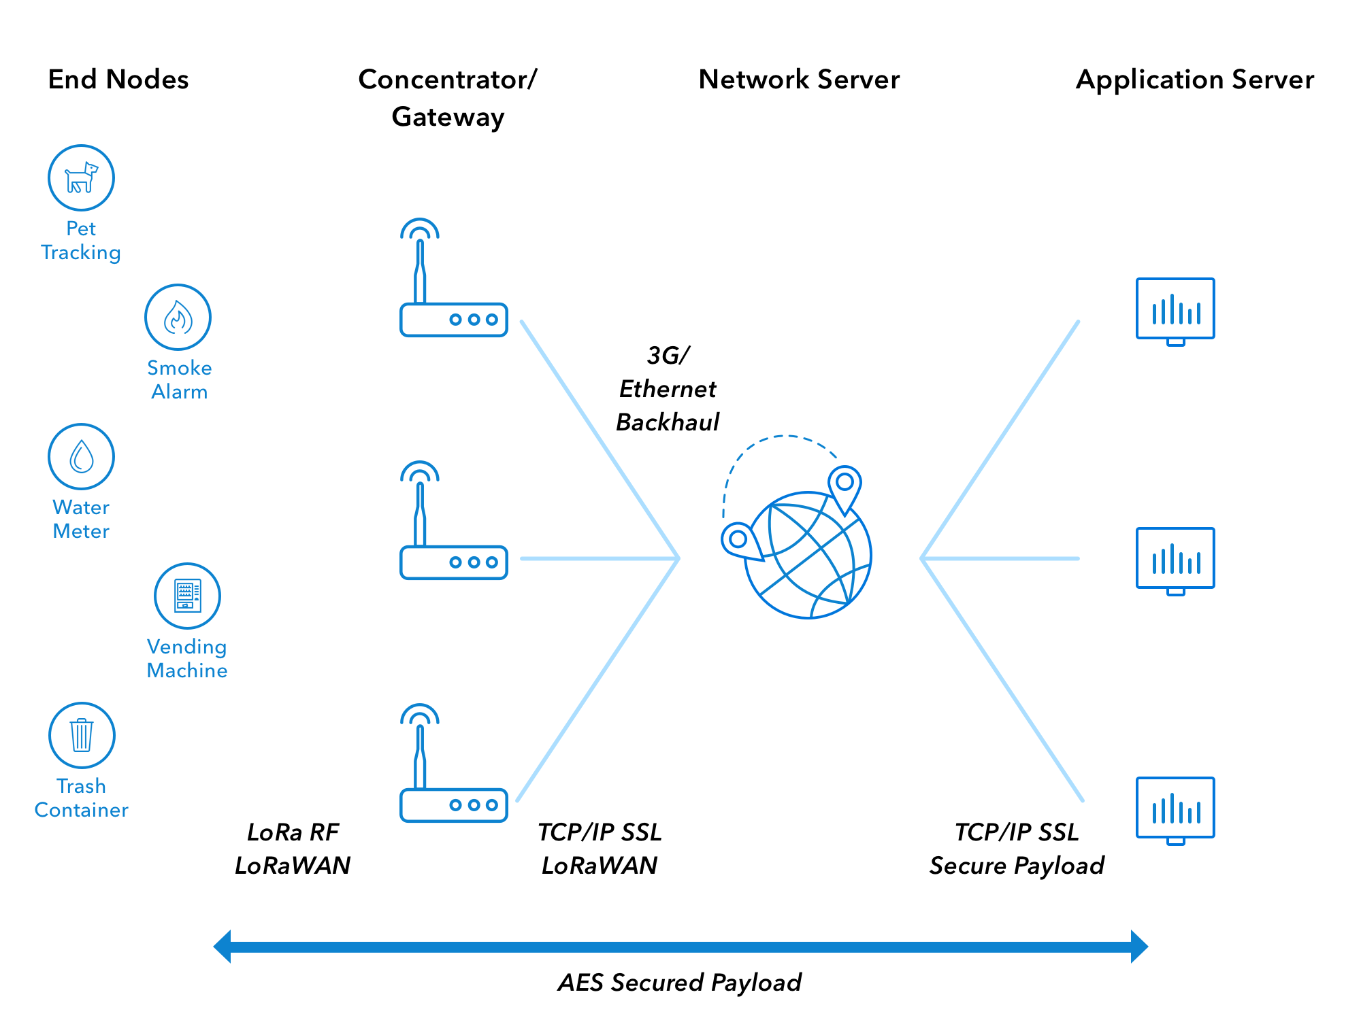
LoRaWAN Network Architecture

Slide 31
It is a star of stars topology in which gateway is a transparent bridge relaying messages between end devices and a central network server in the backend.
{Terminology to look for: End devices or nodes, base stations, uplink, downlink, bidirectional communication, Transmission and Reception windows}
Class A – Downlink available only after sensor TX , battery powered sensors
Class B – Energy efficient with latency controlled downlink
Class C – No latency for downlink communication. Usually mains powered actuators.
LoRaWAN is a media access control layer protocol. At the physical level, we have LoRa custom modulation technology called chirp spread spectrum. It uses license free ISM bands for communication.
Frequency used : ISM bands
The backhaul which connects the Lora bare stations to INTERNET can be any one of the following :
Ethernet / Wi-Fi / Cellular / Satellite
The H/W needed for this is Lora end devices, base stations and gateways. LoRa development kits (1 base station and 2 end devices) are available in India.

Slide 32
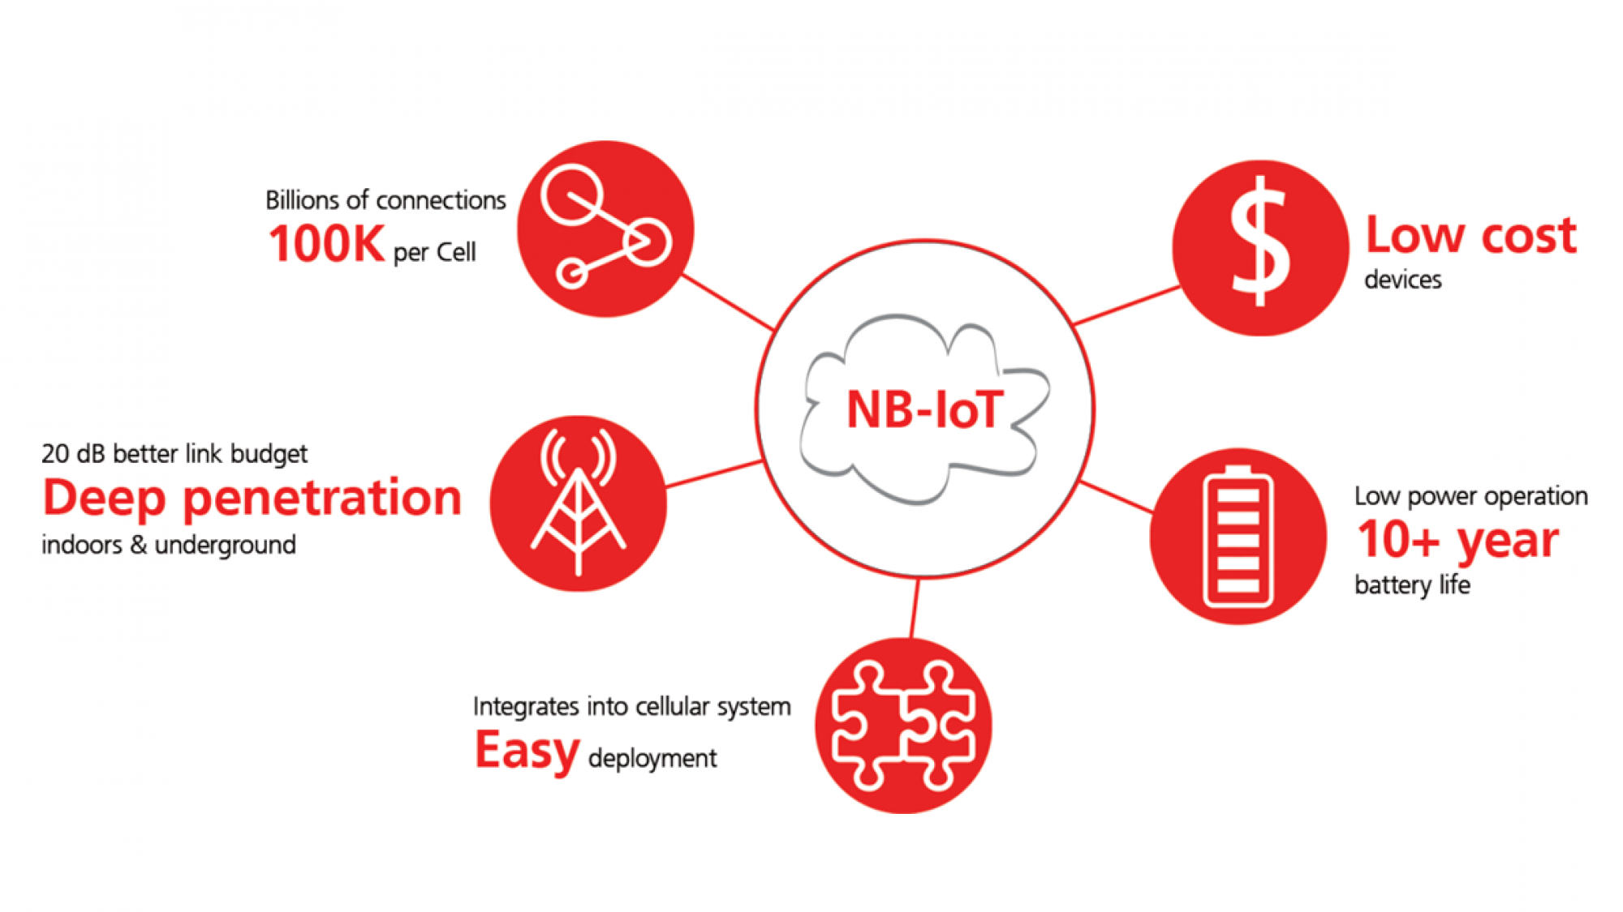
Narrow Band IoT (NB-IoT)
Another LP WAN radio technology standard developed to enable a wide range of devices and services to be connected using TELECOMMUNICATION bands.
Designed for the Internet of things applications and is STANDARDISED by the 3GPP.
The existing 4G cellular infrastructure is enough to deploy NB IoT. A software upgrade needs to be done to all existing 4G systems.
Jio with Samsung are plan to deploy NB IoT in India.
If we are using this mechanism, we need only NB IoT modules at the device end side (similar to GSM). Companies like mediatek (MT2625) and ublox have already developed the modules for NB IoT.

Slide 33
Comparison of various LPWANS
Parameter | LoRaWAN | Sigfox , Telensa | NB-IoT
Frequency Spectrum | Unlicensed (ISM band) | Unlicensed (ISM band) | Licensed – LTE in band / Guard band / standalone
N/W Coverage | Least in urban environment & susceptible to interference | Medium coverage | Good coverage
Data rate | 10 Kbps | 100 bps | 200 Kbps
Battery life | Good | Good | Good
Base station Maintenance is part of our project. | Yes , thus requiring more time and effort to make a product. | No , third party operators or the company itself will provide. | No, Cellular N/W , similar to GSM base stations
Ecosystem | Semtech formed the LoRa alliance and standardizing the LoRaWAN | Deployed in more than 30 countries and trying to expand their N/W | 3GPP is standardizing this and all the telecom companies have the potential to deploy this N/W
Is it ready in India ? (As of today) | Yes, can be tested by purchasing base station and end device modes. Tata Communications has setup base stations in different cities. | No, these companies haven’t come to India yet | Jio with Samsung are planning to setup

Slide 34
GSM/GPRS communication - Networking Link available on board with Linkit One
The main controller MT2502 has the GSM/GPRS integrated with ARM7 EJ-S core , BT and Wi-Fi.
GPRS communication can be used in the applications via functions of LGPRS class in Mediatek Linkit one API of the SDK.
A normal size sim card slot is given on the board.
A patch antenna is also provided along with the board.

Slide 35
Step 3
Cloud(Server , DB , Dashboard UI)
Platform
Development Cycle

Slide 36
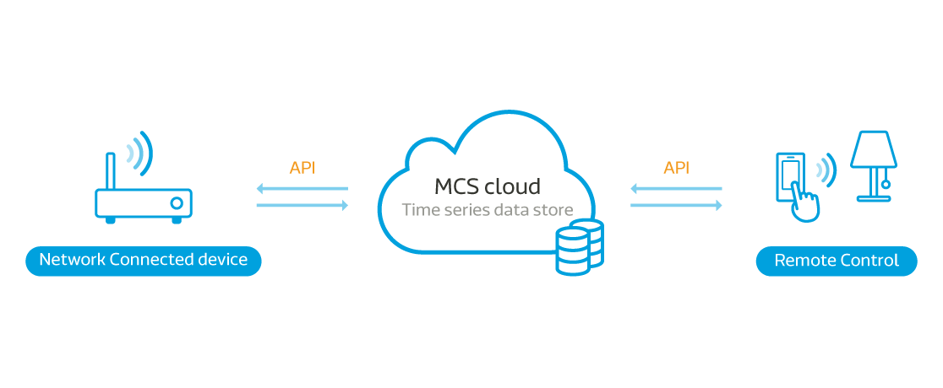
Platform
Platforms available : PubNub , Thingspeak , Mediatek Cloud Sandbox , Ubidots , etc.
Platform Chosen : Mediatek Cloud Sandbox (MCS) as it is developer friendly and feature rich.
MediaTek Cloud Sandbox (MCS) provides free cloud-based data and device management services used in the development and pre-commercial testing of Wearable and IoT devices. It frees you from having to develop your own cloud infrastructure to support such prototype development.
Use RESTful APIs to collect data from the devices and view the data on a powerful web-based dashboard that offers a range of display and graphing options as well as the ability to issue commands to control your Wearable and IoT devices. In addition, a complementary smartphone app lets you review collected data and control your devices anytime and anywhere.

Slide 37
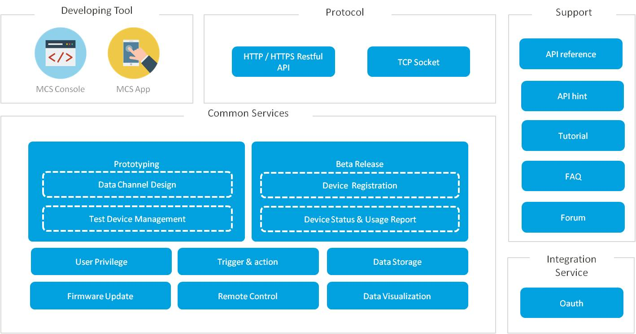
With MediaTek Cloud Sandbox you can :
Define Wearables and IoT prototype profiles and individual devices within a profile
Push and Pull data points between a device and the MCS such as geo-location, temperature, humidity and more
Remotely control your devices using state data points, such as switch-state and more
Visualize data points graphically
Receive email or Mobile Push notifications when data points are collected or changed
Manage device’s life cycle, in the same manner as in a live implementation
Manage and control devices remotely, using the complementary mobile app
Create reports about the prototypes, devices and collected data
Perform FOTA (Firmware Over the Air) updates
Control access to data and devices with granular security control

Slide 38
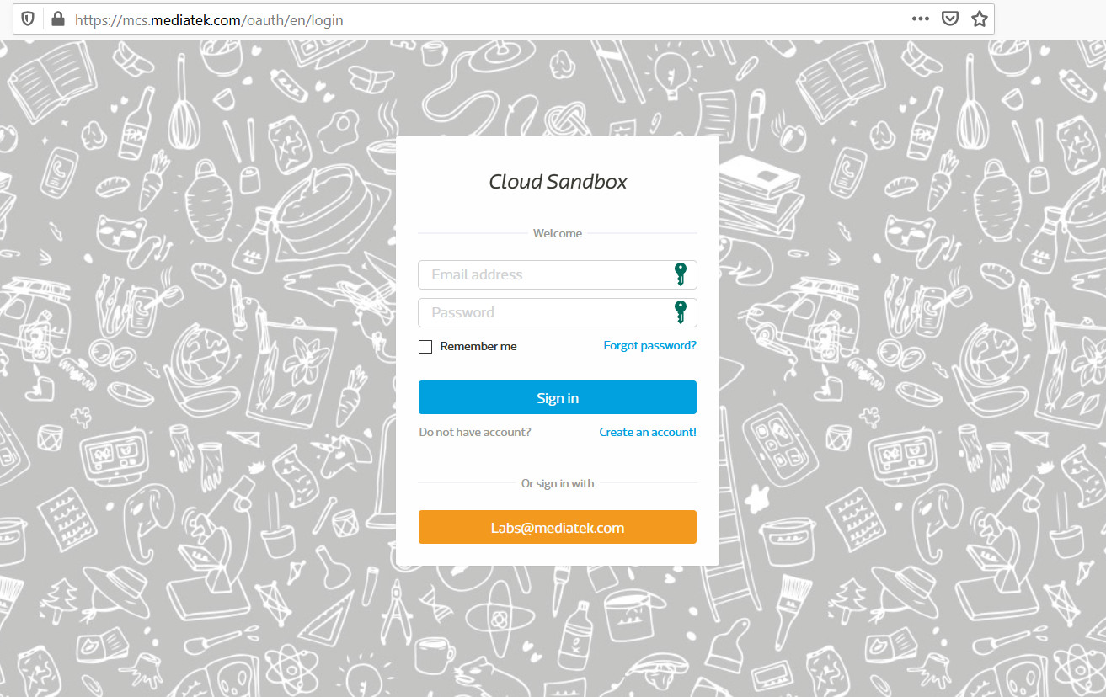
Development Cycle
1. Login

Slide 39
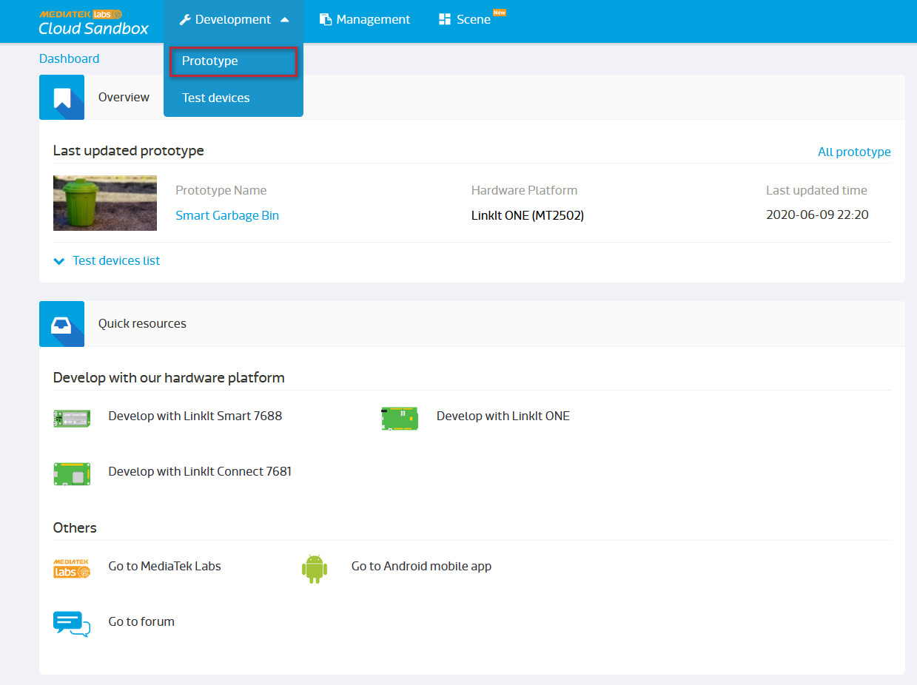
2. Create Prototype

Slide 40
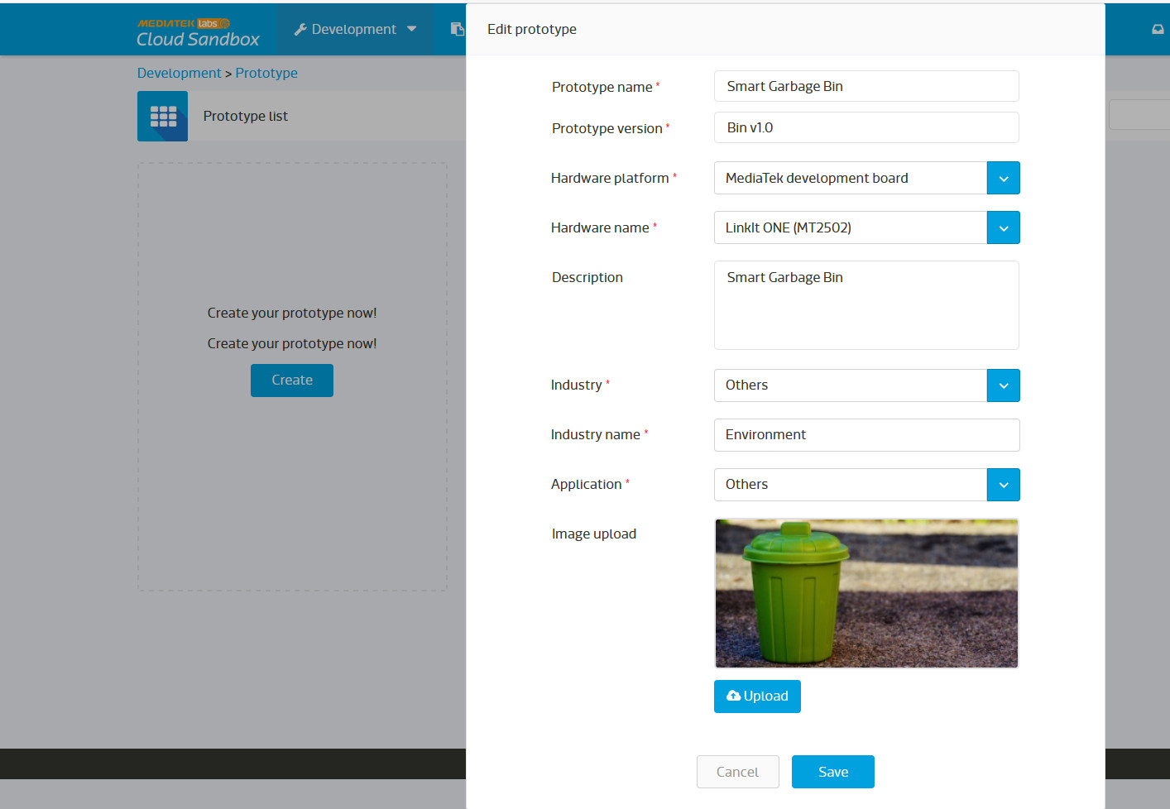

Slide 41
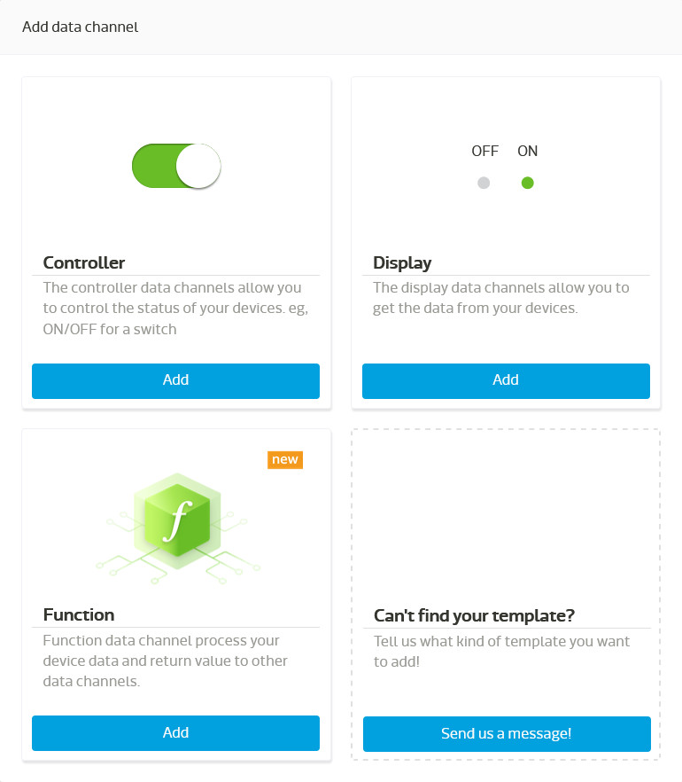
3. Add Data channel

Slide 42
Identify the Variables required
S No. | Variable (Data channel name) | Data channel ID | Data channel Type | Units/data
1 | Location | GPS | Display | GPS Coordinates
2 | Temperature | Temperature | Display | Degree Celsius
3 | Ultrasonic Distance | Ultrasonic | Display | Inch
4 | Garbage Level Indicator | GarbageLevel | Function | Inch
5 | Garbage Bin Level | BinLevel | Display | Category(3)
6 | Battery Level | Battery_Level | Display | Percentage
7 | Counter | Counter | Display | No. of updates

Slide 43
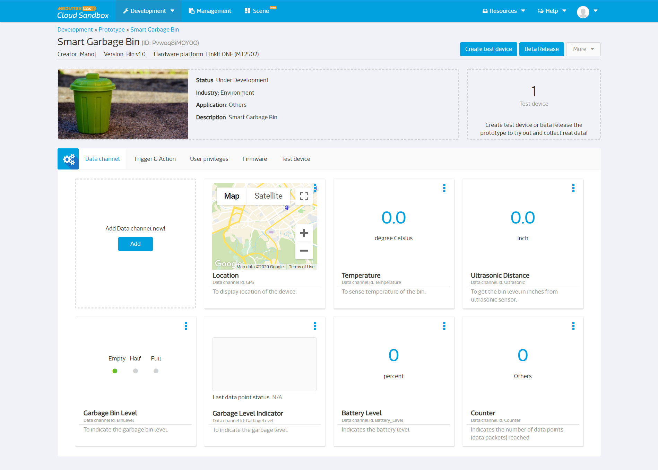
Final Prototype

Slide 44
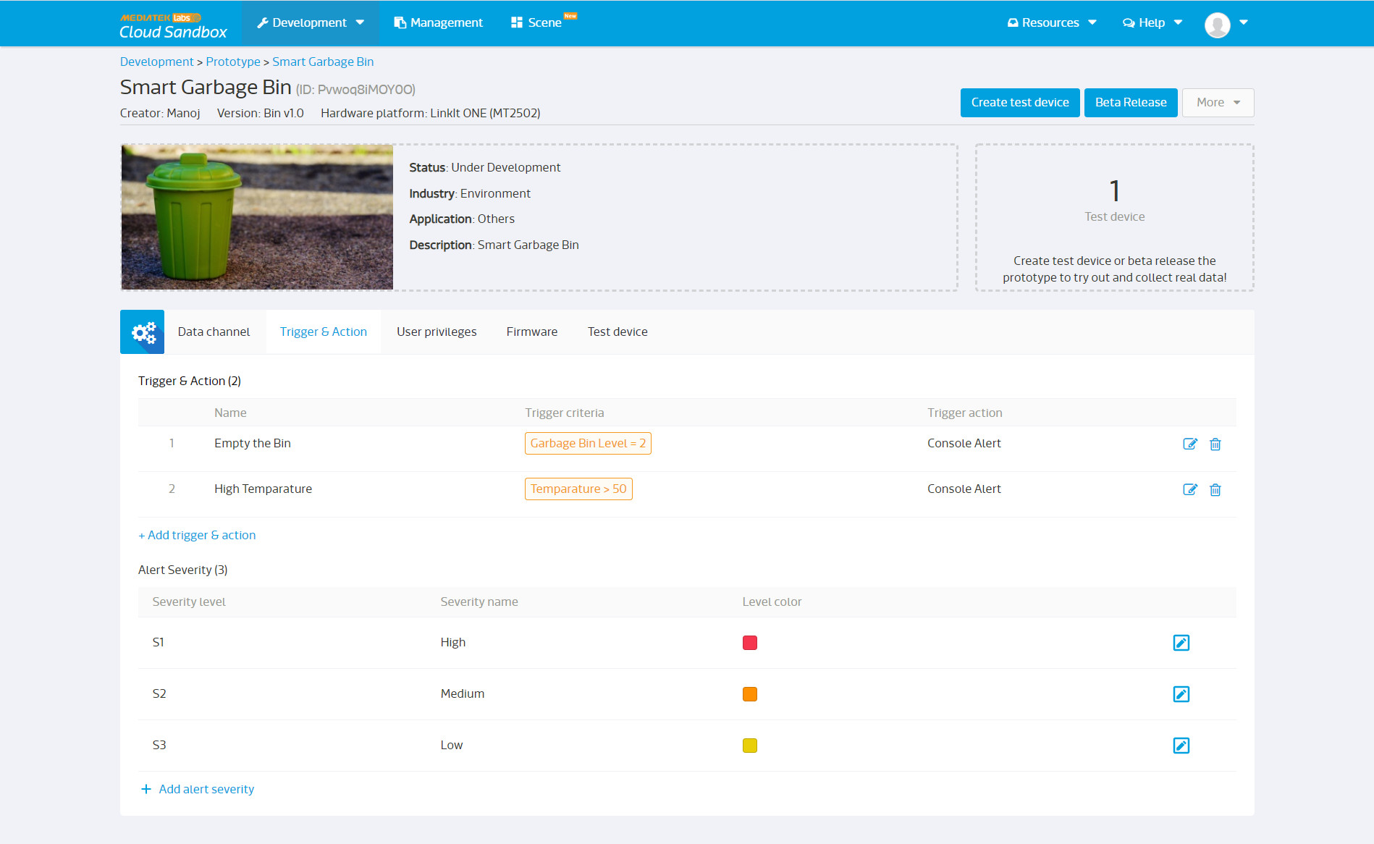

Slide 45
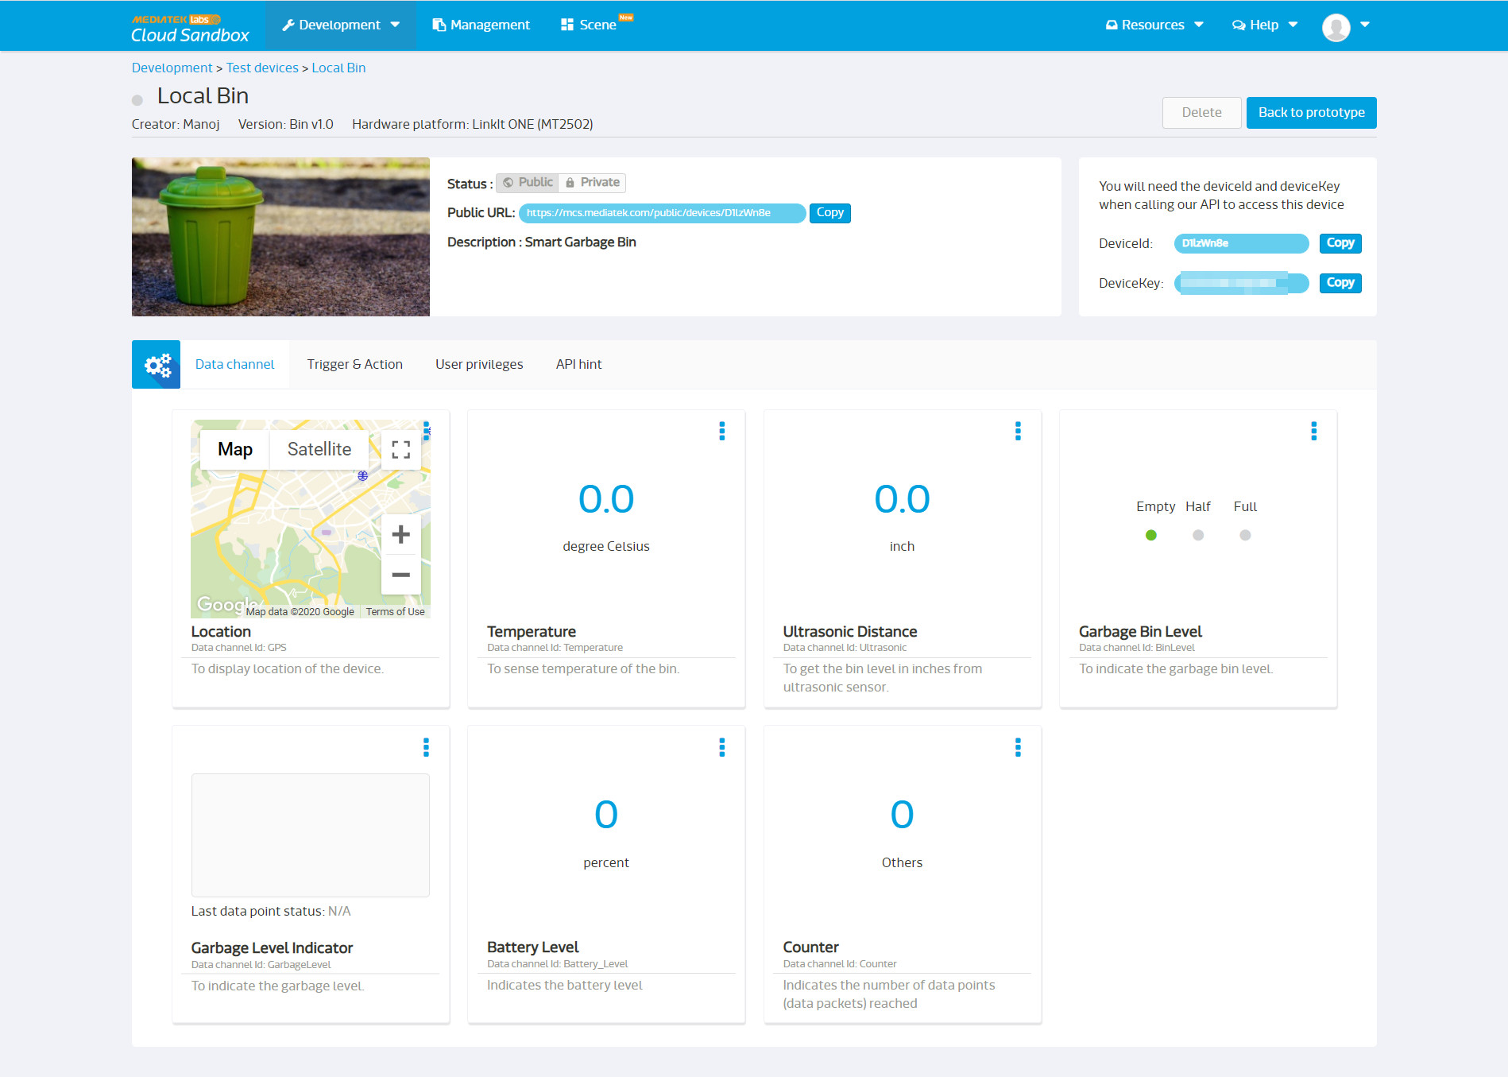
4. Create test device

Slide 46
5. Connect test device
After writing the code to interact with the cloud , start the device. Now your device is sending the data to the cloud and receiving the data from the cloud.
Switch No. | Functionality | Position 1 - Functionality | Position 2 - Functionality
1 | Program Mode | MS： In this position, when connected to PC, Linkit One board will be shown as 10MB USB drive. The program will not execute in this mode. Any file that is copied to this drive can be read via the code. | UART : This position is used to set the board to program mode. Firmware can be uploaded in this mode.
2 | Power | BAT： Board powered by Li-ion Battery. To charge battery, set the switch to this position and connect the board to PC. | USB: Board powered by USB port. Set the switch to this position when there is no battery connected to program the board.
3 | SD/SPI | SPI：This position allows access of external SPI pins (D10 - D13) | SD: This position allows the code to access SD card. This mode also disables access of SPI pins (D10-D13).

Slide 47
6. Manage and control the test device
7. Beta release prototype
8. Create device
9. Manage released devices

Slide 48
Step 4
S/W Development
(Application Program)
Setup up the development environment
Application Development

Slide 49
Set up the development environment
We have used the Linkit one board in Windows environment. The process of setting up the board in windows is as follows:
Installing Arduino IDE
Installing Linkit ONE SDK (Just a plug-in to Arduino IDE)
Configure Arduino IDE to use a Linkit ONE development board
Creating project
https://docs.labs.mediatek.com/resource/linkit-one/en/getting-started/get-started-on-windows/install-the-arduino-ide-and-linkit-one-sdk

Slide 50
S/W development on Linkit one board
Arduino Constructs :
Two default functions are there for every project in Arduino IDE
Setup function -> Executed only once after reset. Sensor initialization is done here.
Loop function -> Executed repeatedly like a while(1) loop in micro controllers.
Accessing components on board:
The hardware on the board can be accessed only through the software interface given by Mediatek. All the feature of board are exposed as classes in this interface.
http://labs.mediatek.com/api/linkit-one/frames.html?frmname=topic&frmfile=index.html

Slide 51
Http GET and POST from the board
The remote module has to interact with the cloud to update any sensor value or get any configuration change.
Refer to the Mediatek cloud APIs to UPLOAD DATA POINTS (POST) and RETRIEVE DATA POINTS (GET). CSV format is used in the app.
Go to Resources → API references (in your mediatek cloud sandbox account) to find out how to interact with the Mediatek cloud.

Slide 52
Example of Http POST request :
include <HttpClient.h>
include <EthernetClient.h>
EthernetClient content;
HttpClient http(content);
content.println("POST /mcs/v2/devices/D1lzWn8e/datapoints.csv HTTP/1.1");
#hint! Please do not add excessive spaces
String data = "GPS,,12,13,14"
#timestamp is in unix-time format the milliseconds and is optional. If not provided,
#system will generate timestamp at the time of receiving this API
int dataLength = data.length();
content.println("Host: api.mediatek.com");
content.println("deviceKey: EscXXXXXXXXXXXXX");
content.print("Content-Length: ");
content.println(dataLength);
content.println("Content-Type: text/csv");
content.println("Connection: close");
content.println();
content.println(data);

Slide 53
Application development
Algorithm
SETUP FUNCTION
Initialize the N/W Interface (service provider)
Setup up the Temperature sensor
Setup up the Ultrasonic sensor
Initialize the GNSS module
Initialize the serial communication (Used for debugging)

Slide 54
LOOP FUNCTION
Get the values of Latitude , Longitude and altitude from the GNSS module
Get the value of battery level
Get the values of temperature , ultrasonic distance from the respective sensors
Read the values of Counter
Also send the ultrasonic distance value for the GarbageLevel function in the cloud
Arrange the values in a csv format
Send all these values (7) to the cloud in a Http POST request
Wait for 30 minutes.

Slide 55
Test cases

Slide 56
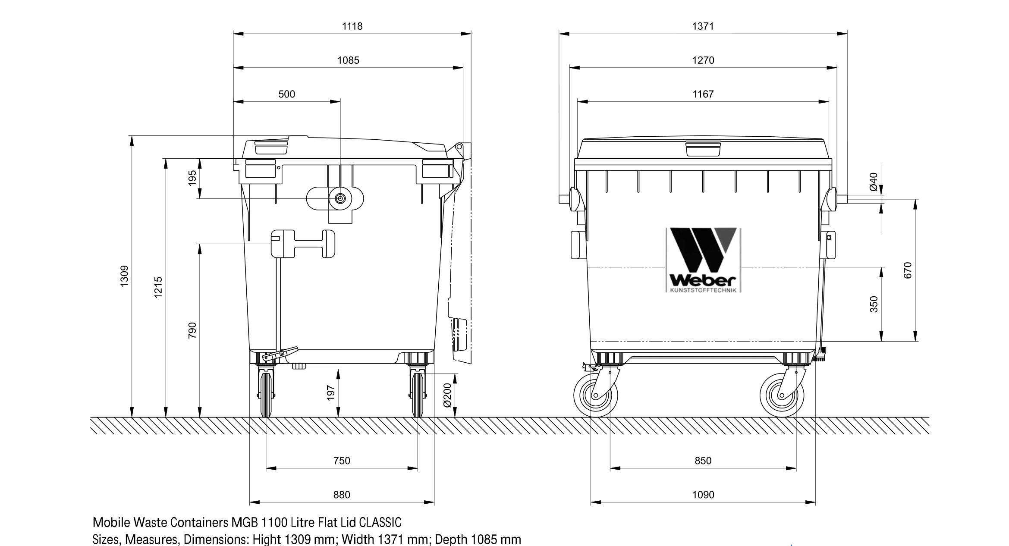
Dimensions of dustbin considered for Test Cases

Slide 57
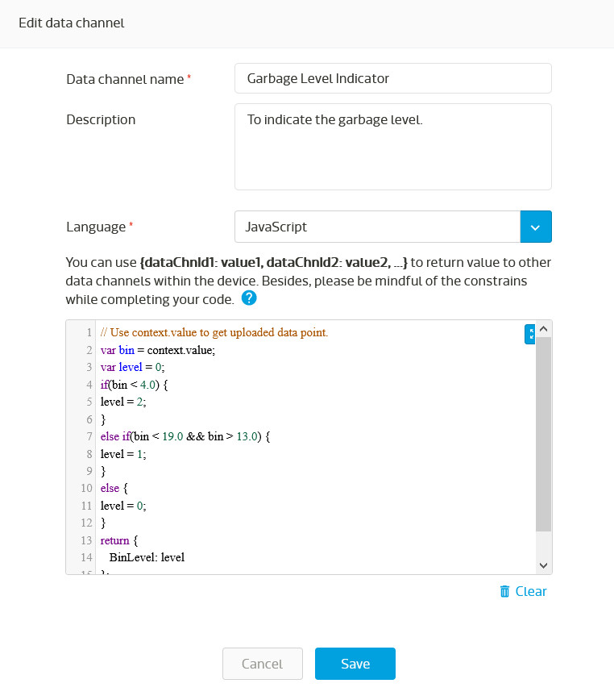
Data channel type : Function
ID : GarbageLevel
Responsible for showing Empty / Half / Full – Bin Level

Slide 58
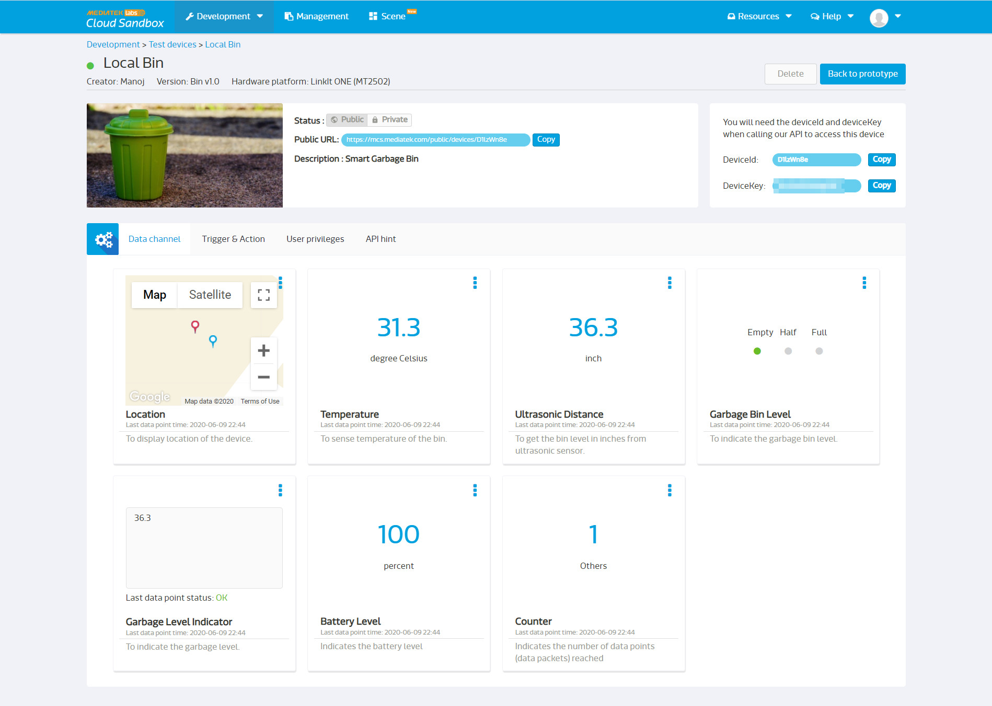

Slide 59
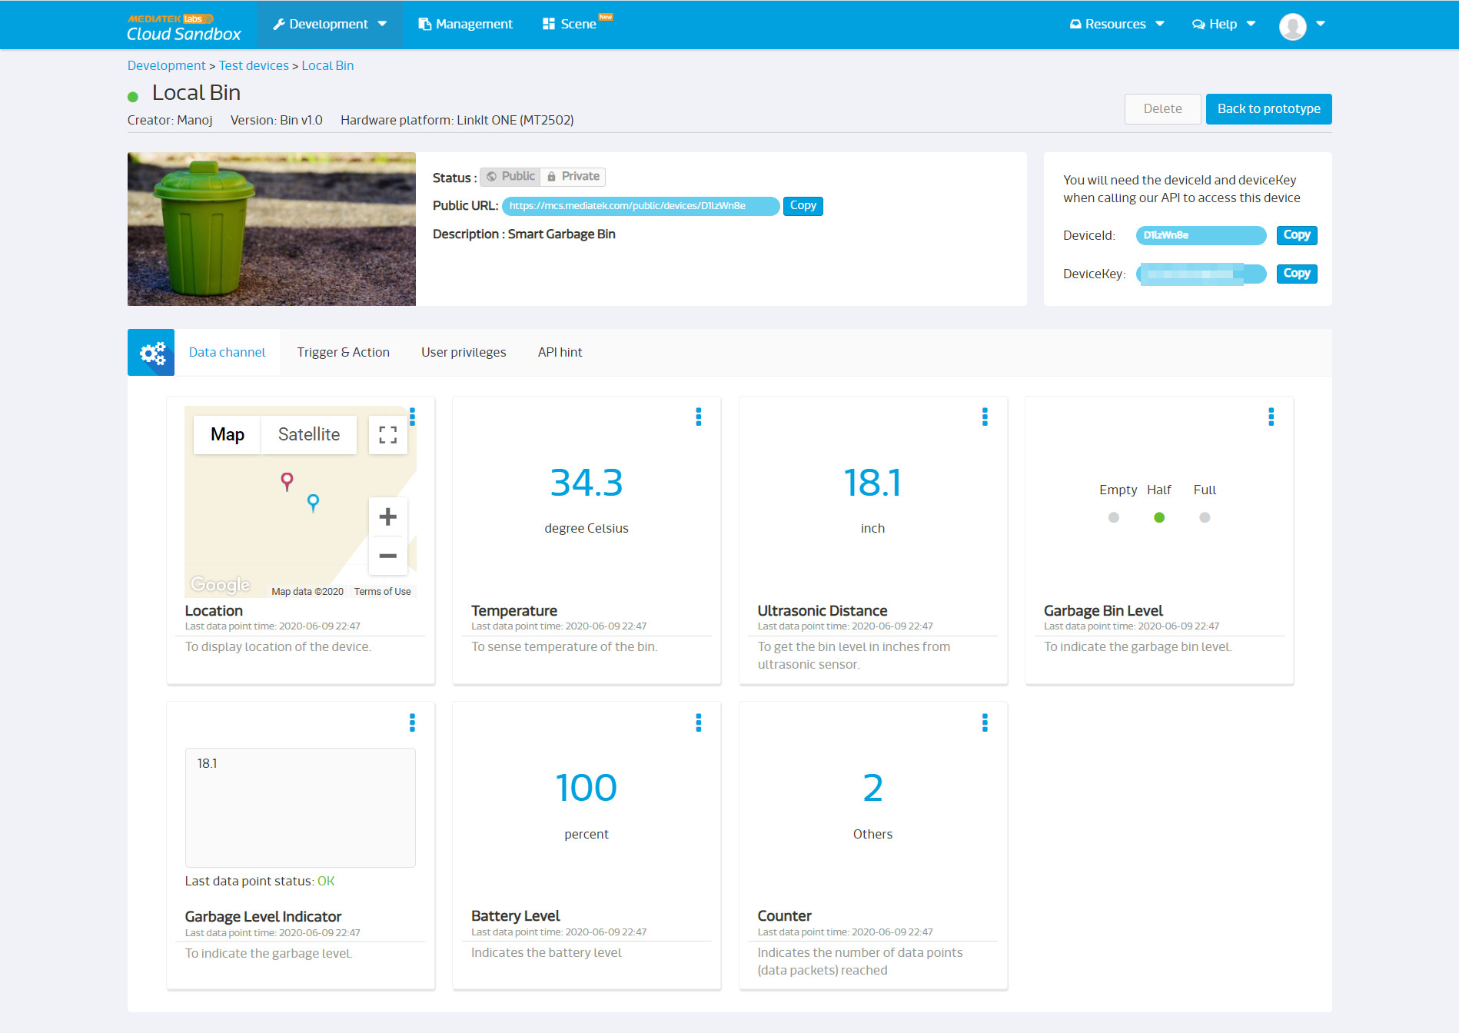

Slide 60
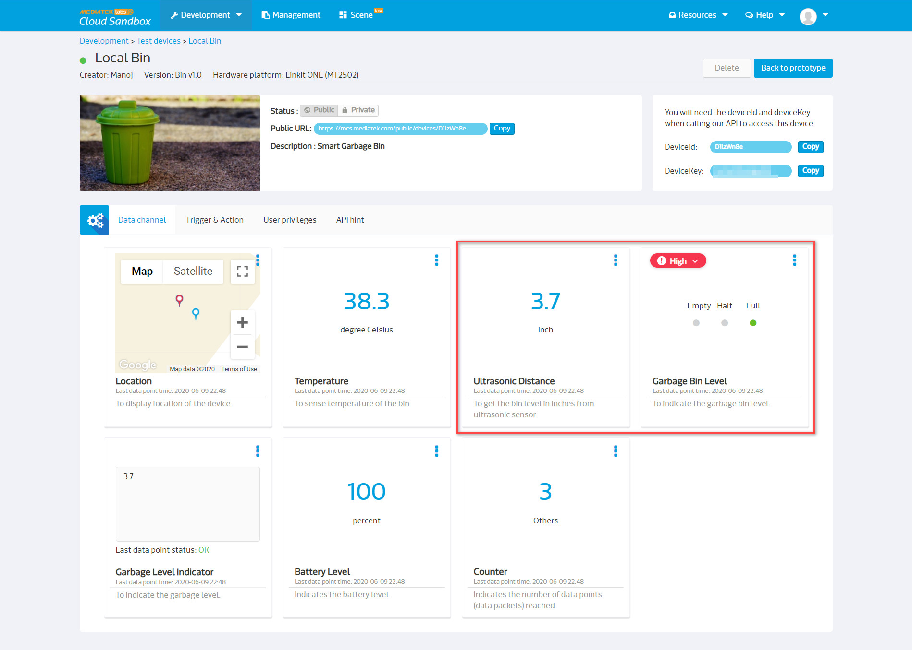

Slide 61
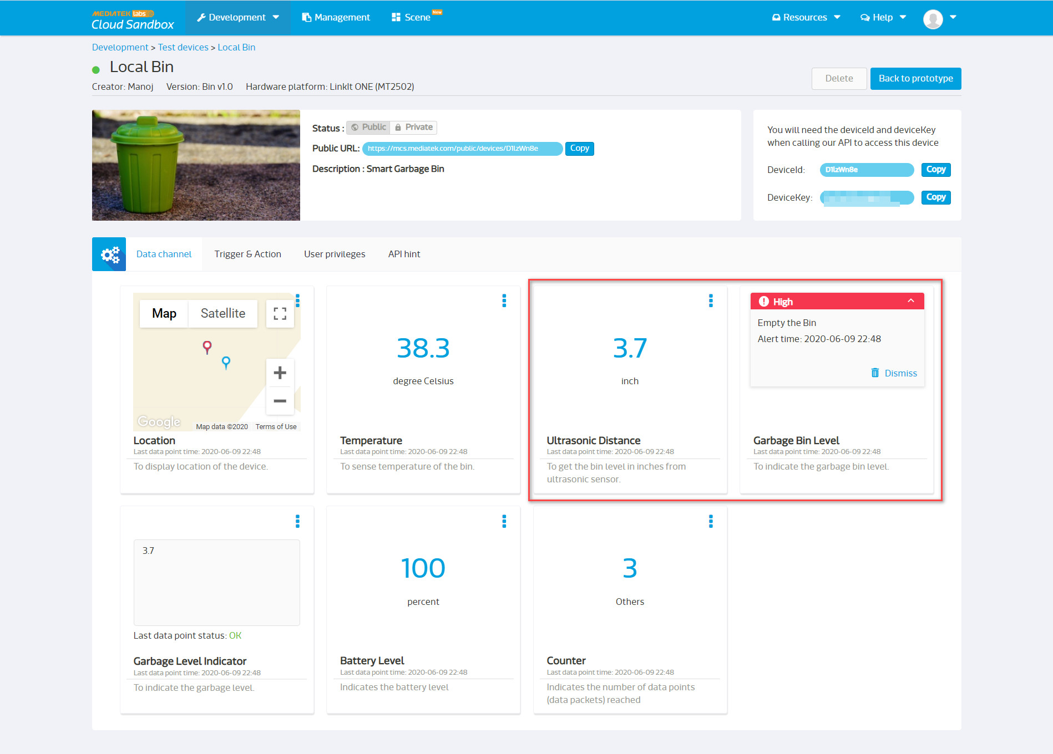

Slide 62
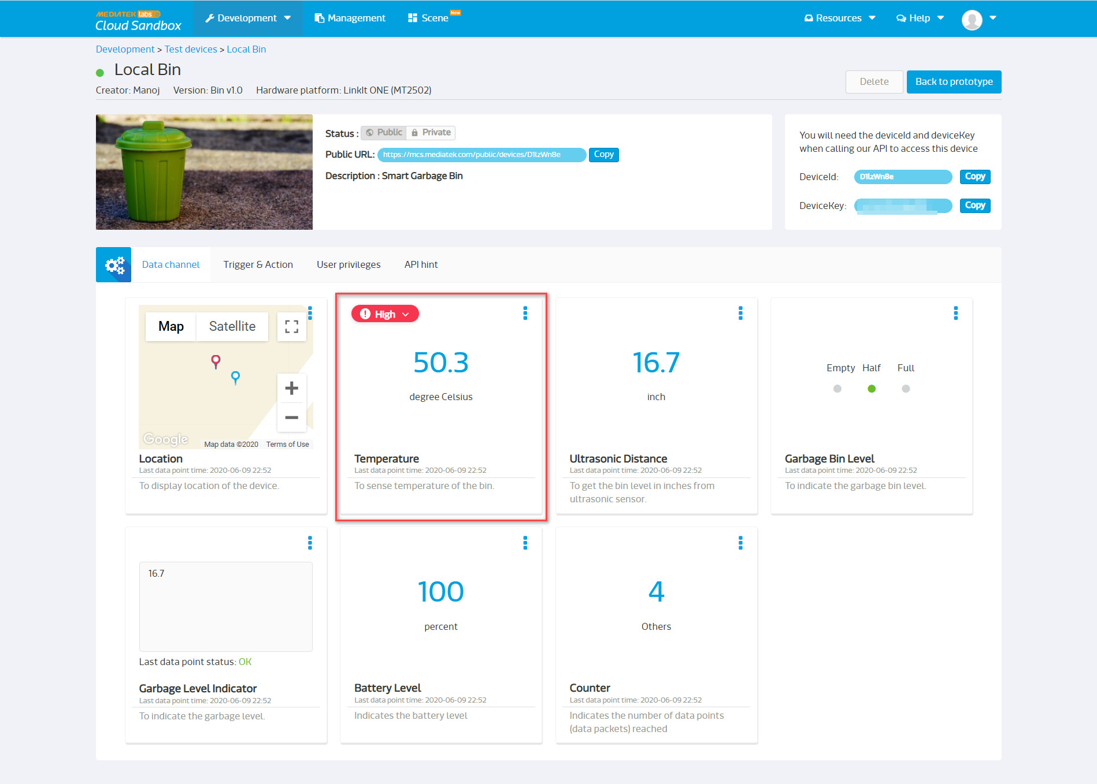

Slide 63
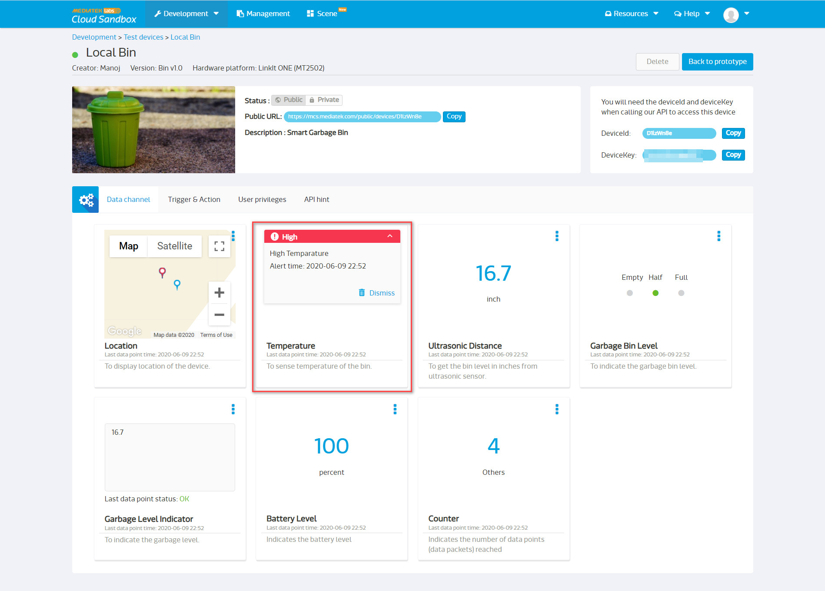

Slide 64
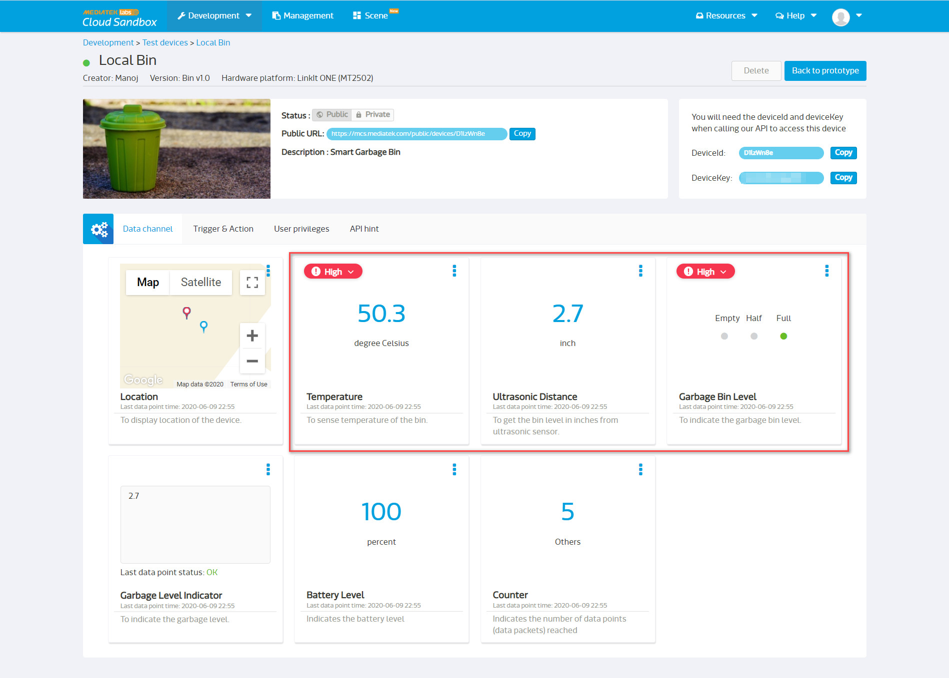

Slide 65
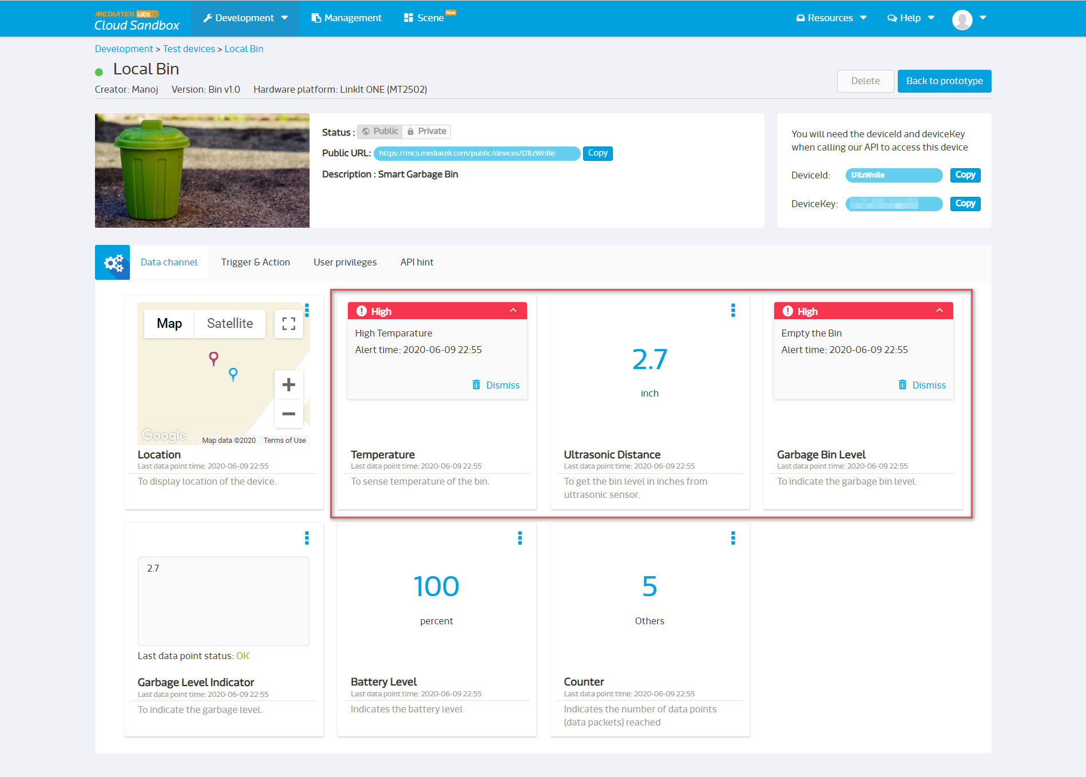

Slide 66
Smart Garbage bin
Public Device Link
https://mcs.mediatek.com/public/devices/D1lzWn8e

Slide 67
Step 5
Prototype to Product
Challenges
Future Updates

Slide 68
Challenges
Features Proposed : Temperature , Bin Level , Location
Features Delivered : Temperature , Bin Level , Location
Environment wear and tear issue : IP Resistance 66
Battery backup
Ultrasonic Sensor : Wide beam sensor to Narrow beam sensor
Future upgrades
Foul smell sensor : (NH3/H2S/CH3SH)
Battery backup : Solar power
Wireless Connectivity : LoRa (868 Mhz)

